Slide 1
IMAGINE AI

Slide 2
Group Members Mahnoor Ijaz (21-NTU-CS-1329) Kainat Murtaza (21-NTU-CS-1323) Abubakar Nadeem (21-NTU-CS-1291)

Slide 3
Problem

Slide 4

Precision in Image Search
Traditional image search engines often struggle to provide precise results based on specific textual prompts. This limitation arises from the reliance on keyword matching and metadata, which may not capture the nuanced context or desired elements of an image. As a result, users may encounter frustration and inefficiency when attempting to find visuals that accurately reflect their needs or preferences.

Slide 5
Solution

Slide 6
AI-Powered Image Generation
Our solution leverages artificial intelligence (AI) algorithms to generate images based on specific textual prompts provided by users. By training machine learning models on vast datasets of images and associated text, we enable our system to understand and interpret complex semantic relationships, resulting in more accurate and relevant image generation. This approach circumvents the limitations of traditional keyword-based search methods, offering users a precise and tailored visual experience.

Slide 7
Fuzzy Logic

Slide 8
01
02
03
Text- Interpretation
Interpret user text descriptions as fuzzy sets to map descriptive words to image attributes.
Image Generation
Use fuzzy rules to align image characteristics with the nuances of the text description.
Filter Application
Apply and blend filters based on fuzzy sets to achieve desired artistic styles.

Slide 9
04
Version Generation
Create image variations by applying fuzzy logic to define subtle differences.
User Selection & Preferences
05
Fine-tune images using fuzzy logic based on user feedback.
Social media sharing
06
Enhance images using fuzzy adjustments tailored to platform-specific preferences before sharing.

Slide 10
Data Set

Slide 11

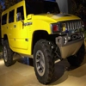
Use these Images/data to Train our AI Model
Planes
Car

Slide 12
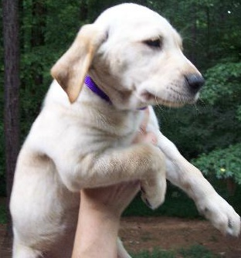
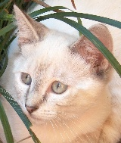
Use these Images/data to Train our AI Model
Cat
Dog

Slide 13
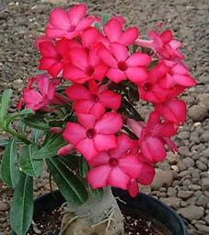
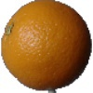
Use these Images/data to Train our AI Model
Flowers
Fruits

Slide 14
Framework

Slide 15
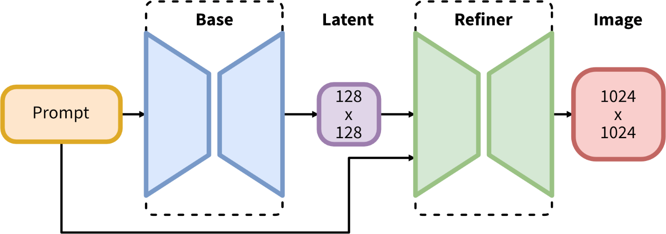

Slide 16
Results

Slide 17
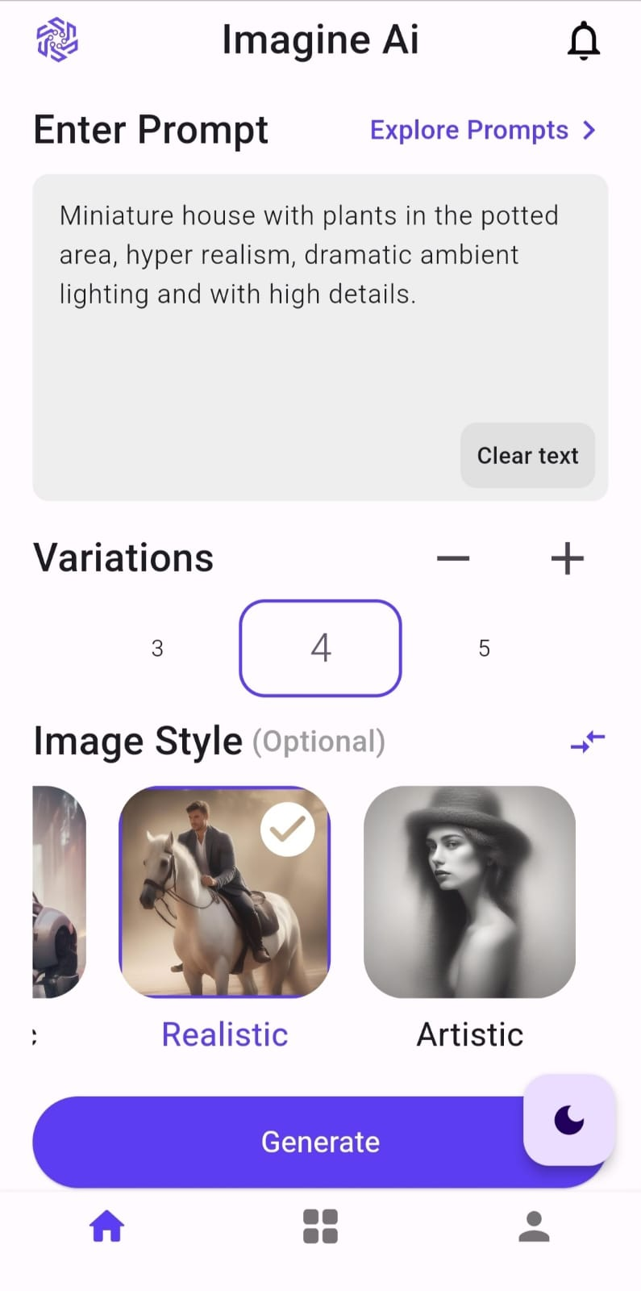
Enter Text Prompt
Select Image variations
Select image filters

Slide 18
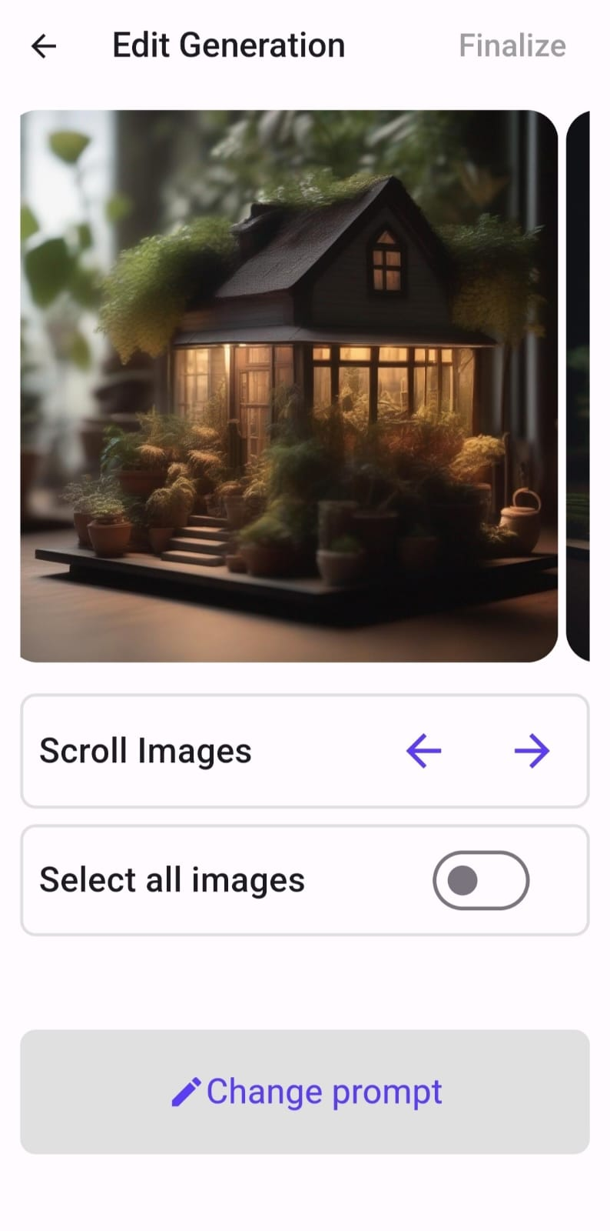
Images generated
Scroll Images
Select images to download
Select images to share on Social Media

Slide 19
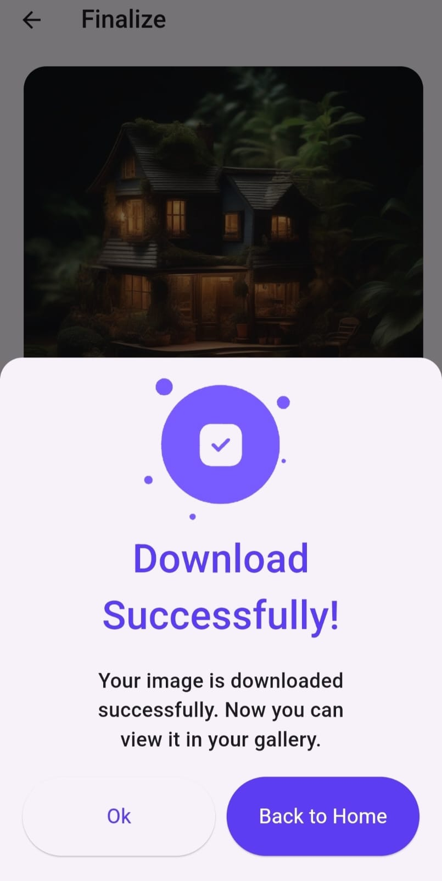
Images downloaded successfully
Image can be shared

